Slide 1
Teaching Responsibility
David Lawrence Center
Prevention Department

Slide 2
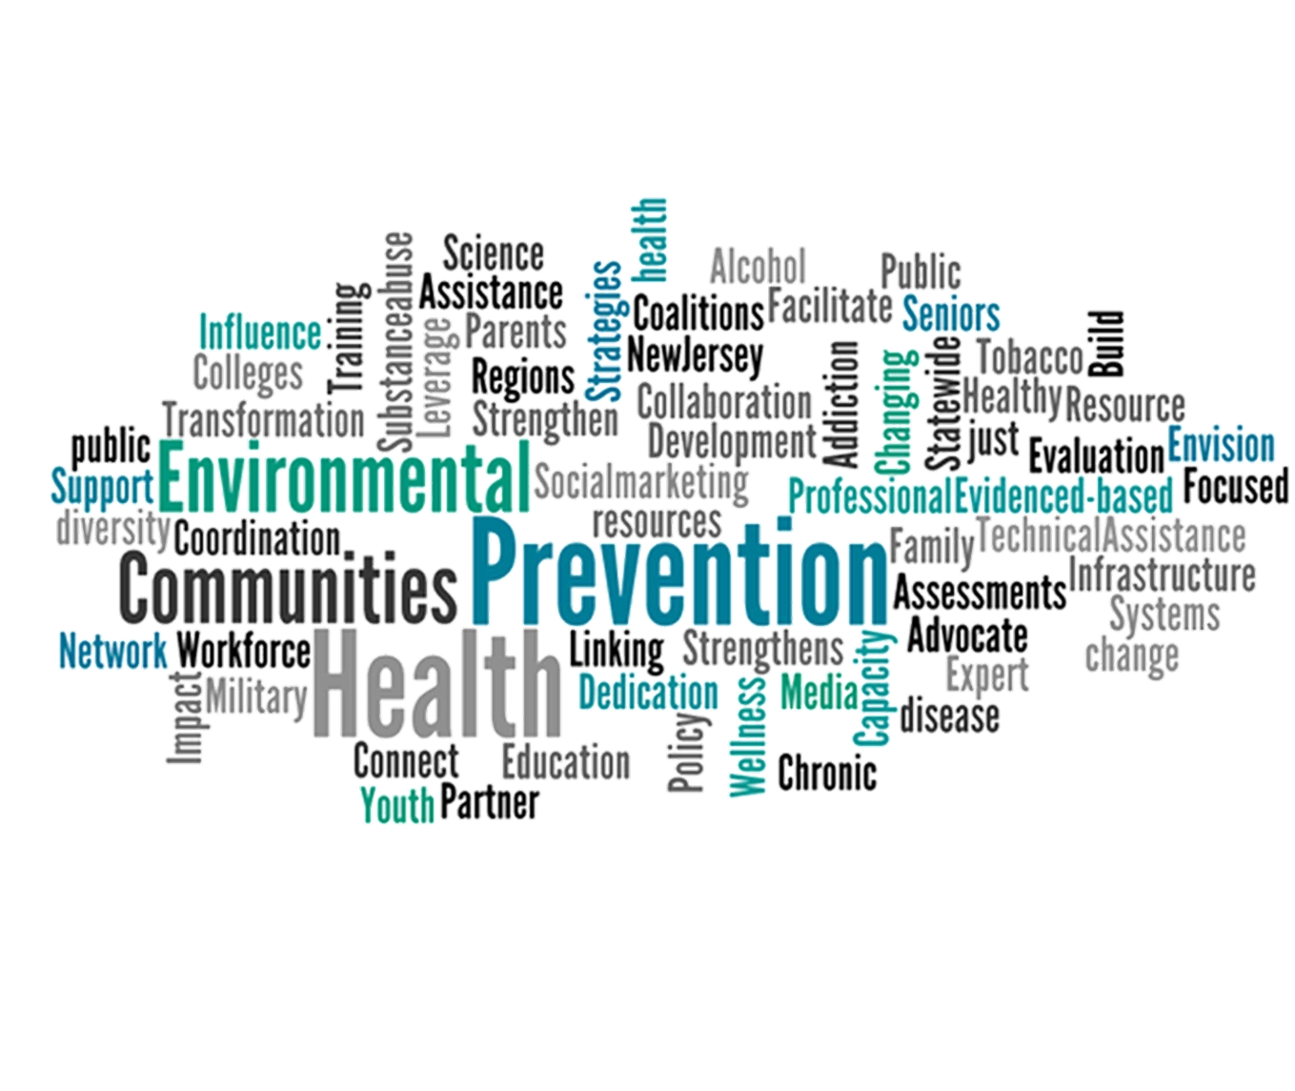

Slide 3
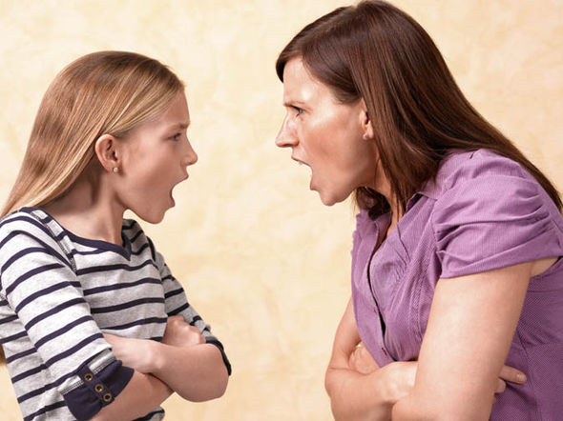
Responsibility
A responsibility is something you are expected to do.
Accepting obligations
Doing the right thing as the situation calls for it.
R= C+C
Teaching kids to take responsibility for their actions and to responsibly perform tasks is a key step toward character maturity and success.
Why is this important?
Notes:
Responsible people accept that living cooperatively with others sometimes requires that you do things you might not feel like doing. This can mean anything from doing your homework to showing up to a family wedding when you’d rather go to a football game.
Responsible people are able to figure out the right thing to do in a given situation and do it even without someone there to make them do it.
Responsibility= Choices + Consequences
When we accept that what happens to us is usually a product of the choices that we make, we are accepting responsibility.
When they accept responsibility for the outcome of their choices, they learn to make better choices in the future. Some of these future choices might be about alcohol, tobacco, drugs, sexuality, or violence.

Slide 4
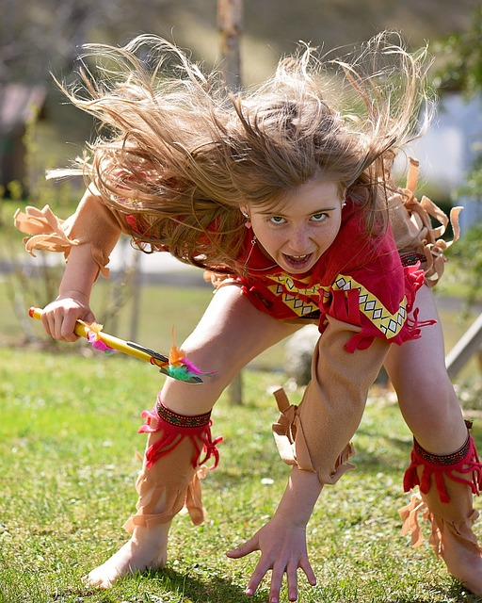
The value of Responsibility
For many people, everything is someone else’s fault. Every problem can be explained away with reasons why they can’t affect the situation or the outcome
Teaching responsibility will prevent children to feel entitle to things they haven’t worked hard enough or simply don’t deserve
Teaching responsibility will show them they’re capable of doing things
Cultivate Self-Esteem
Notes:
Growing up with this attitude will only bring problems in children’s life because they will be blaming everything to someone else instead of learning to make better choices in the future

Slide 5
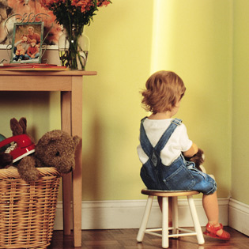
Avoiding Responsibility
Fear of being wrong and, therefore, being blamed or punished
They don’t fully understand consequences
Notes:
I think is fair to say that we’ve all tried to avoid responsibilities in the past just to find out that we still need to do it or that consequences aren’t too pleasant. Sometimes the responsible choice is less fun than the irresponsible choice, at least in the short run. I think we can all relate to this. I’m sure I’m not the only one who have decided to binge Netflix instead of doing laundry or take money from the savings account to buy something I don’t really need but looks way too cool. Children have similar reasons with one big difference. They have a fear of being wrong and therefore being blamed or punished, and they don’t fully understand consequences.

Slide 6
Tips for Teaching
Let them help you
Model responsibility
Praise them
Some age appropriate chores or task for children (toddlers to teens)
Trust them with something “bigger”
Manage your expectations as parents
Provide a routine
Teach consequences in a positive and healthy way

Slide 7
Make it Fun
Plan on baking something together and establish who is responsible of what part of the baking. Example, you’re making cookies and so you will get the ingredients together and your child will mix and make shapes of the cookies.

Slide 8
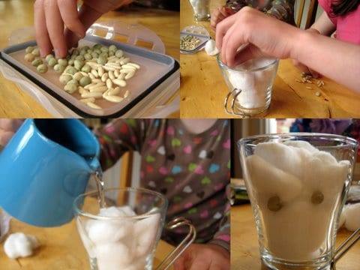
Make it Fun
Crowed Pot: get some seeds, cotton, newspaper, or toilet paper. Have child taking care of the seeds as they germinate. They must be watered everyday but just to keep it moist. Explain children about being responsible and make sure they understand the plants are their (children) responsibility

Slide 9
Wrap Up
Responsibility is something you are expected to do. It’s about doing the right thing as the situation calls for it.
Teaching responsibility will show them they’re capable of doing things, cultivate self-esteem, and avoid entitlement
They avoid responsibility for the same reasons as adults, but they don’t fully understand consequences
There are many ways you can start teaching responsibility at home and it doesn’t have to be boring

